Slide 1

Revision
ISYS2001, School of Marketing and Management

Slide 2
Today
Review ULO
Review Lectures
Discuss Extended Learning Portfolio
Questions
Study Strategies

Slide 3
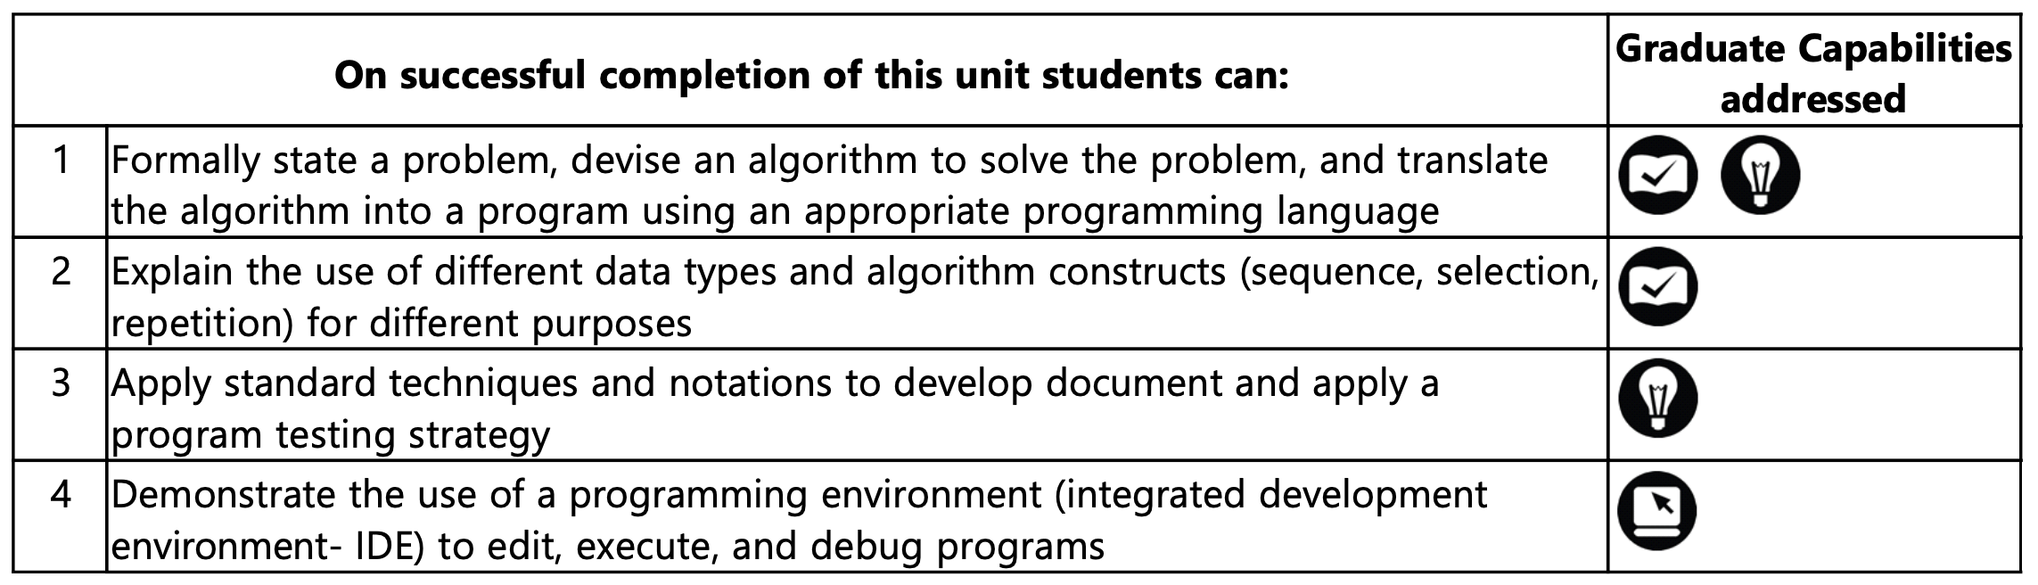
ULO

Slide 4
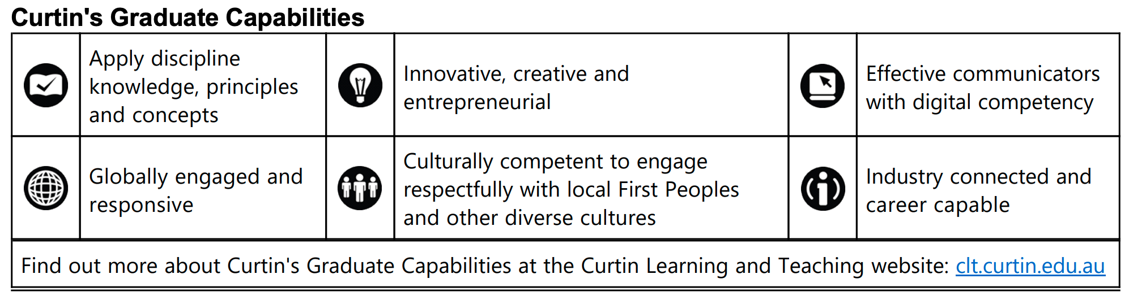
Curtin’s Graduate Capabilities

Slide 5
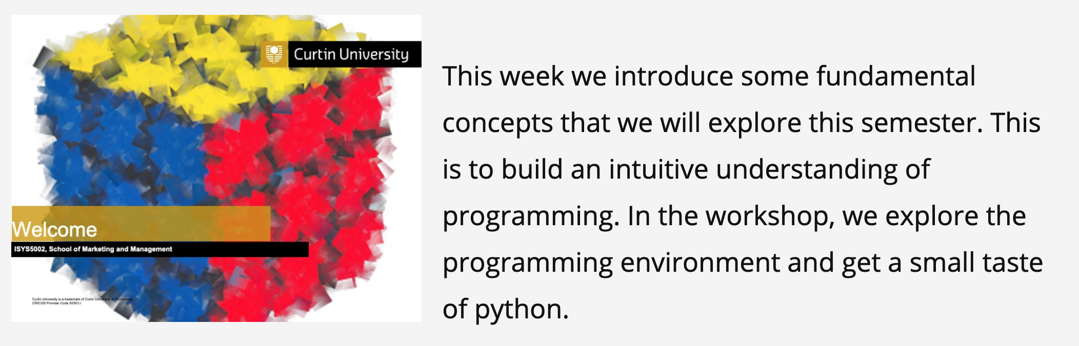
Computational Thinking

Slide 6

Problem Solving

Slide 7
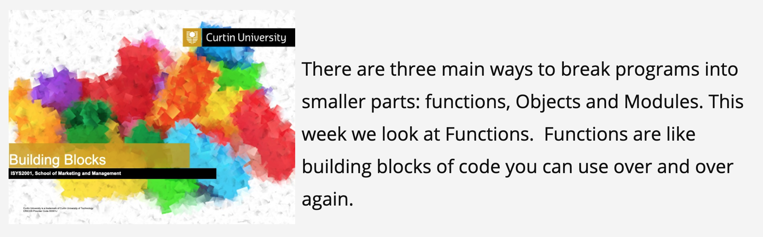
Building Blocks

Slide 8

File IO

Slide 9
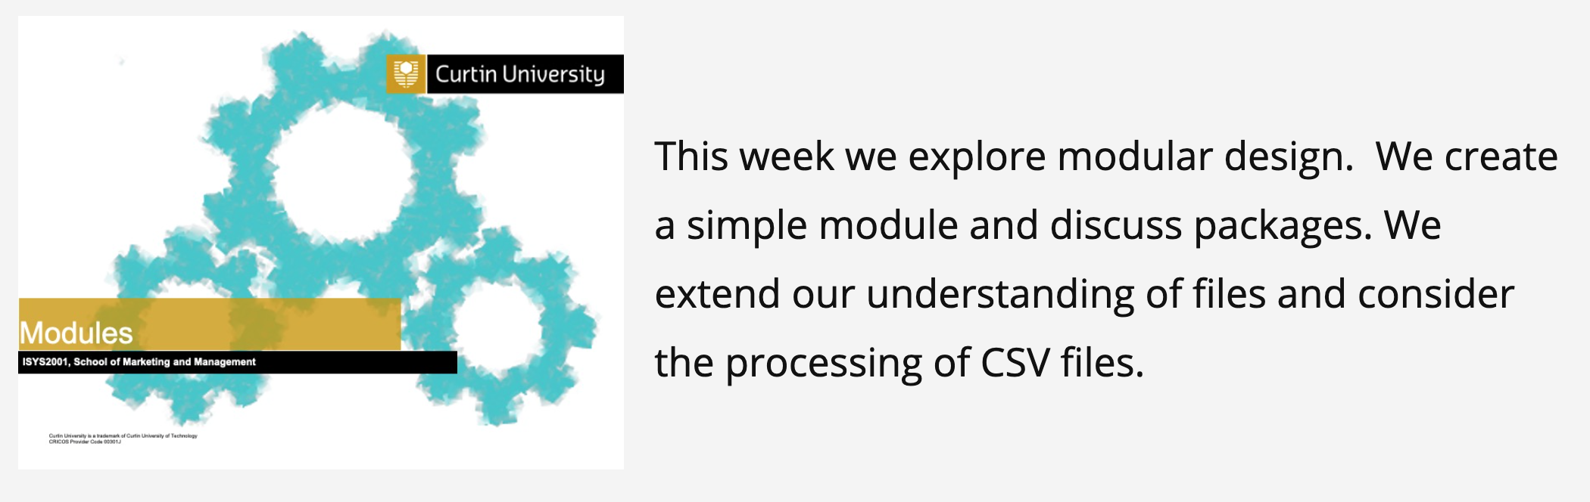
Modules

Slide 10

Testing

Slide 11
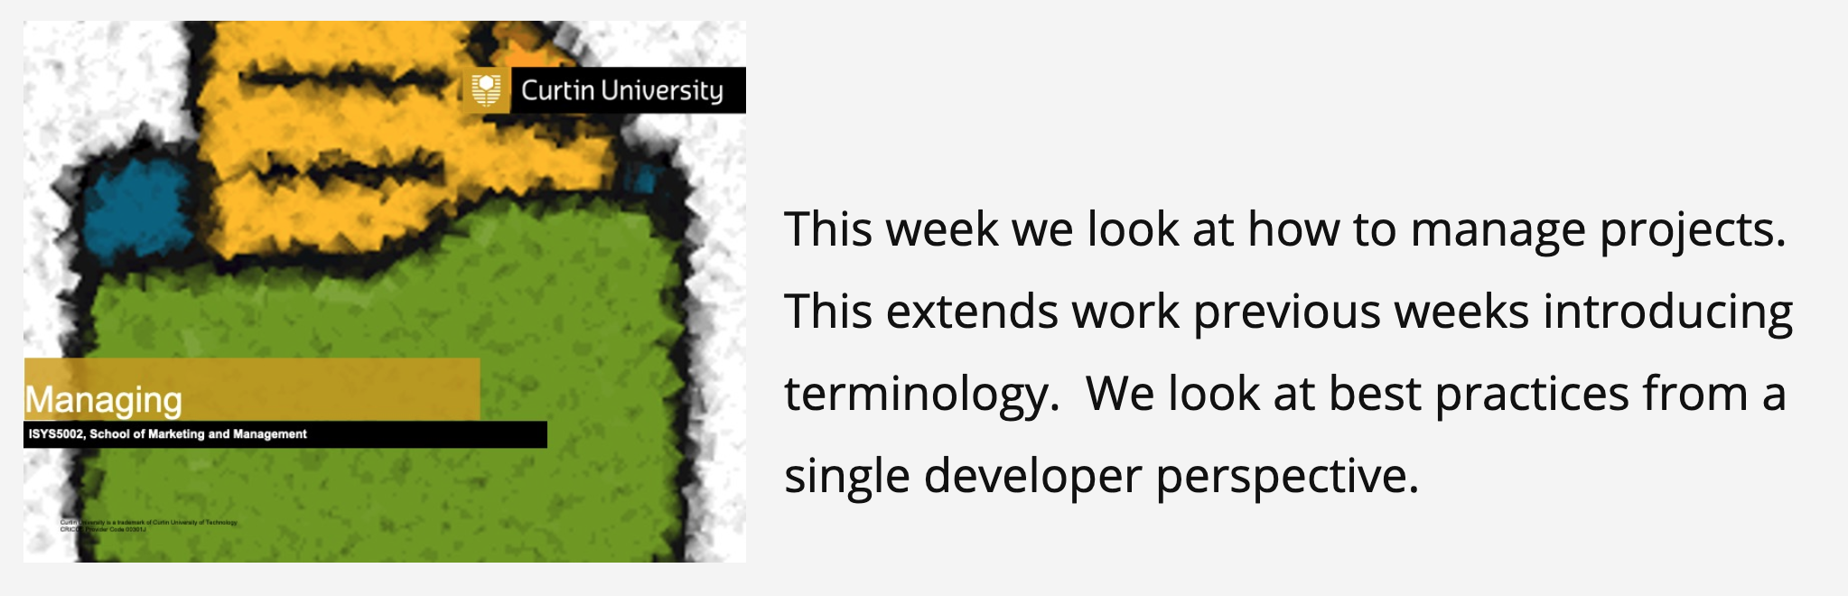
Best Practices

Slide 12
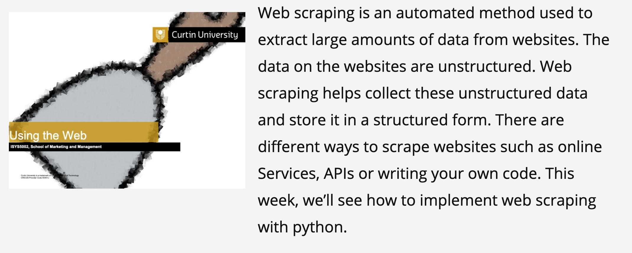
Using the Web

Slide 13
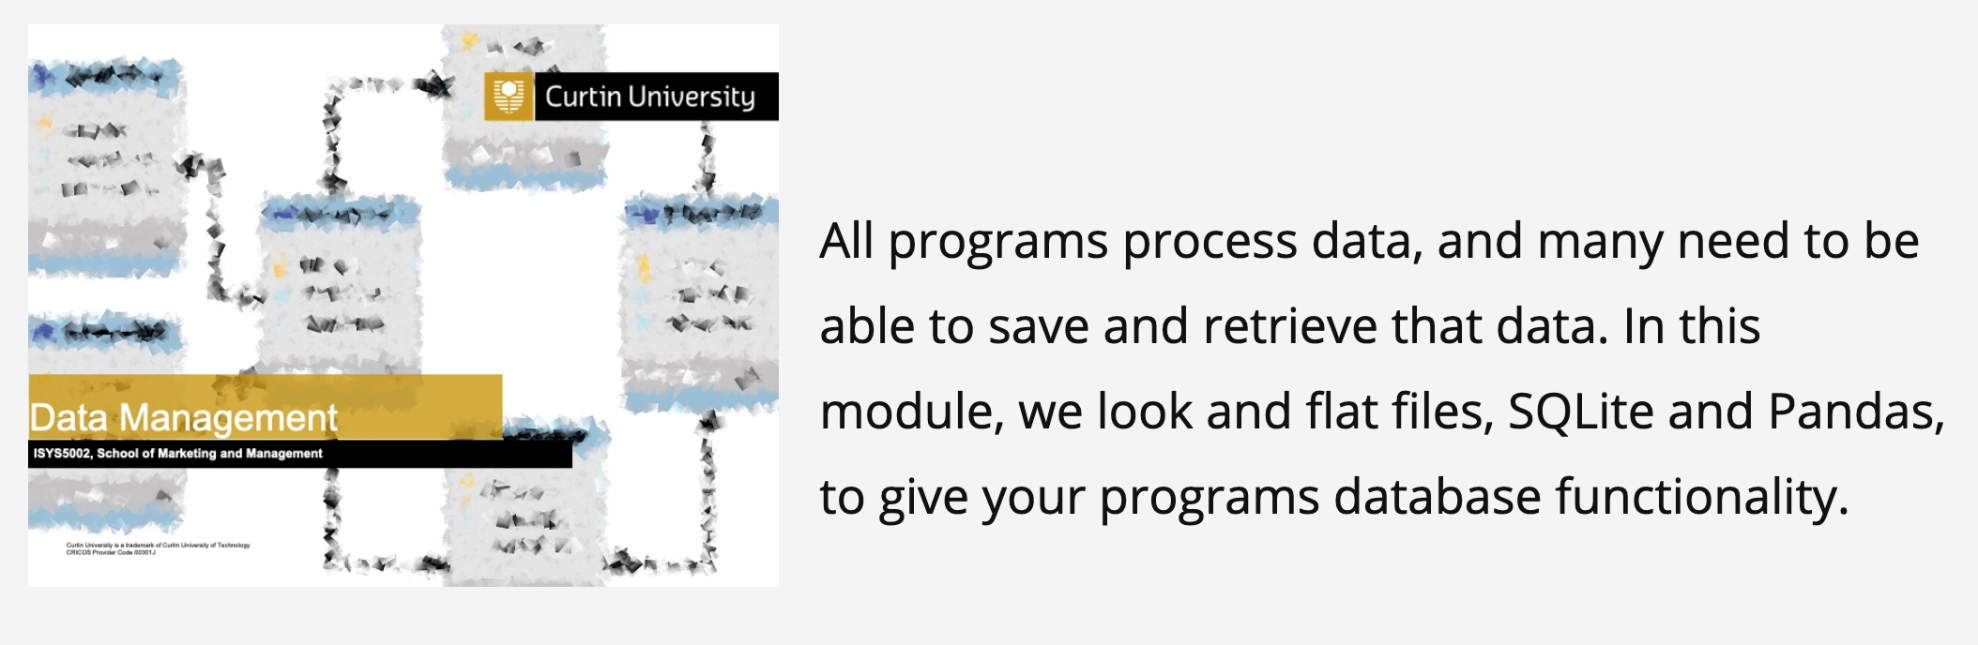
Data Management

Slide 14
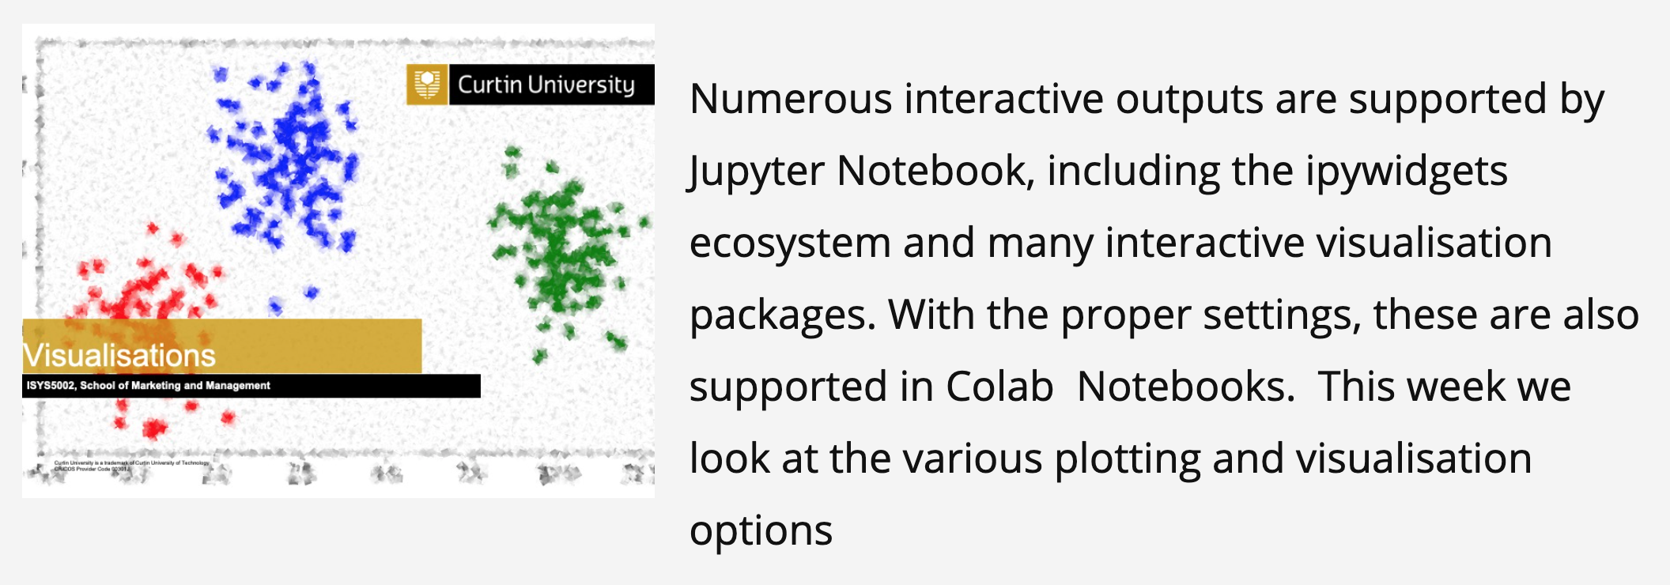
Visualisations

Slide 15

Graphical User Interfaces

Slide 16
Problem Solving Methodology
State the problem clearly
Describe the input and output
Work a simple example by hand
Develop and algorithm (and convert to Python)
Test solution with a variety of data
Feedback Loop(s)

Slide 17
Program
ALGORITHM
INPUTS
OUTPUTS

Slide 18
Six Things
Input
Output
Calculate (Add, multiply, less than etc.)
Store (assignment)
Decide (if-then)
Repeat (for, while)

Slide 19
Core Concepts
Algorithms
Expressed in structured English (Pseudocode)
Sequence (must put things in correct order)
Selection (if-then-else)
Repetition (while)
Encapsulation (group things)
Manage complexity
Data example – lists group values/variables
Code example – function group expressions

Slide 20
Coding is a small part of Programming

Slide 21
(Our) Development Environment
Python Notebook
Code Cells
Text Cells (Markdown)
Interactively run cells
Output in notebook
Workflow
Edit in notebook
Frequently save to GitHub
Deploy Binder/NBViewer/Report

Slide 22
Typical Workflow
Development
Prototype model and outputs
Extract Data
Develop Notebook
Notebook → Script → exe
→ Web App
→ Container
Production
Live Data
Store Outputs
Run App
Notes:
Tradition/Old way, Notebook to Script
New way use container technology and webapps
Other things to consider
DATA PREPARATION. You could run a distinct ETL step at the start of production, have it as a totally separate pipeline, or include it in your main analysis / modeling code.
VERSION CONTROL AND CI. Often the split between dev and prod isn't nearly as clean, so you may go back and forth between the two using tools like Jenkins or Travis. (That also means adding tests into the workflow!)
CONTAINERS AND ENVIRONMENTS. At production time, you'll probably want to package up all your dependencies along with your scripts, especially if you plan to automate
SERVICES AND DEPLOYMENT. These patterns describe your typical batch workflow, but in more complex use cases "production" will also include on-demand or streaming use, and services like APIs and Lambda have unique requirements

Slide 23
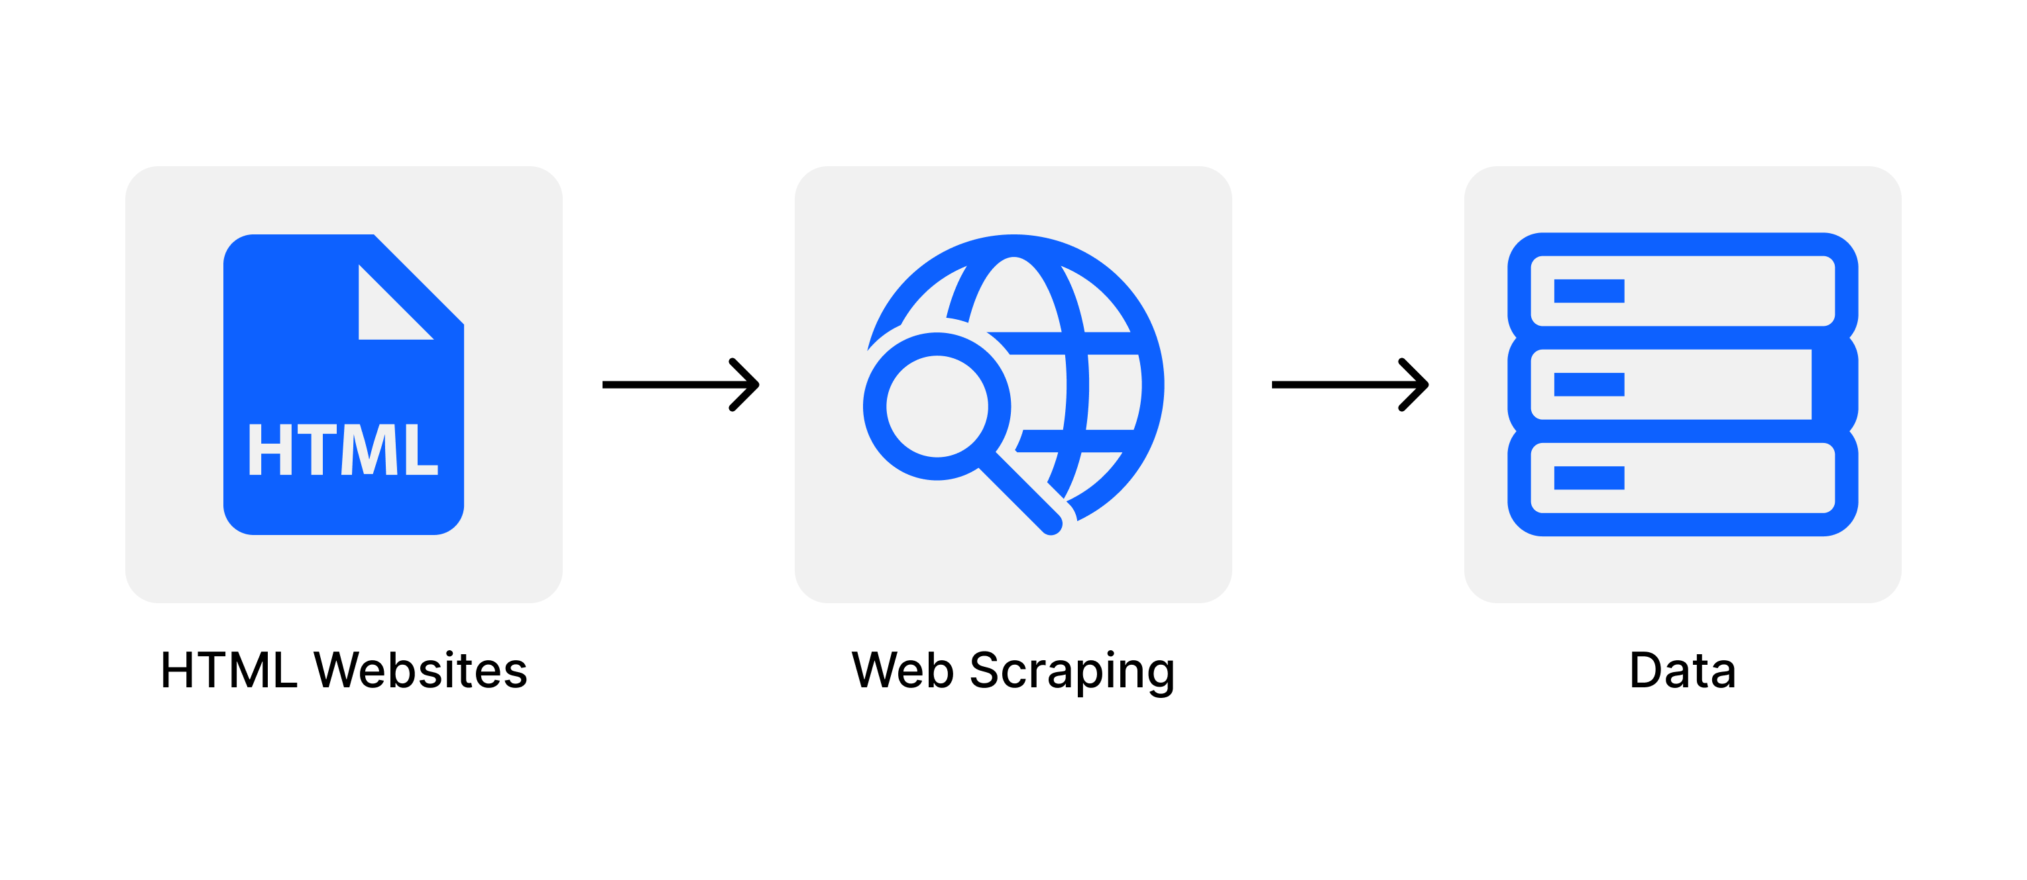
What is Web Scraping
Image Source: https://i.imgur.com/6zM7JBq.png
Notes:
Web scraping is an automated method used to extract large amounts of data from websites. The data on the websites are unstructured. Web scraping helps collect these unstructured data and store it in a structured form. There are different ways to scrape websites such as online Services, APIs or writing your own code. In this article, we’ll see how to implement web scraping with python.

Slide 24
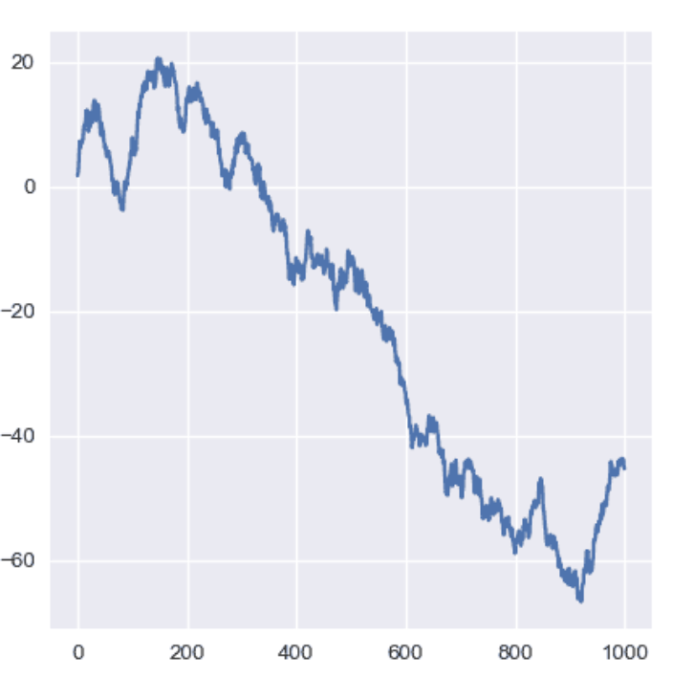
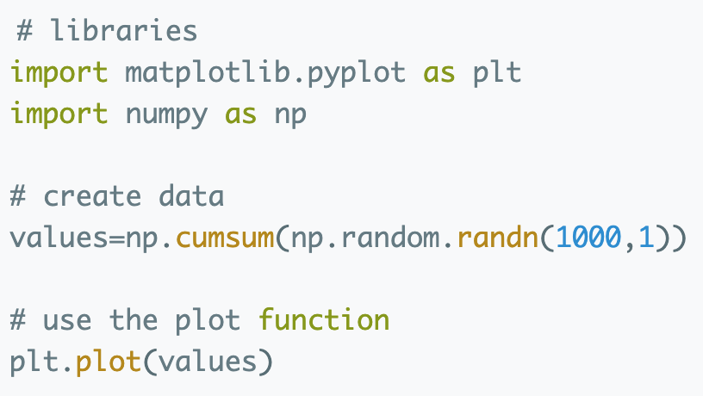
Python Graph Gallery
Plot + Code
https://python-graph-gallery.com/line-chart/

Slide 25
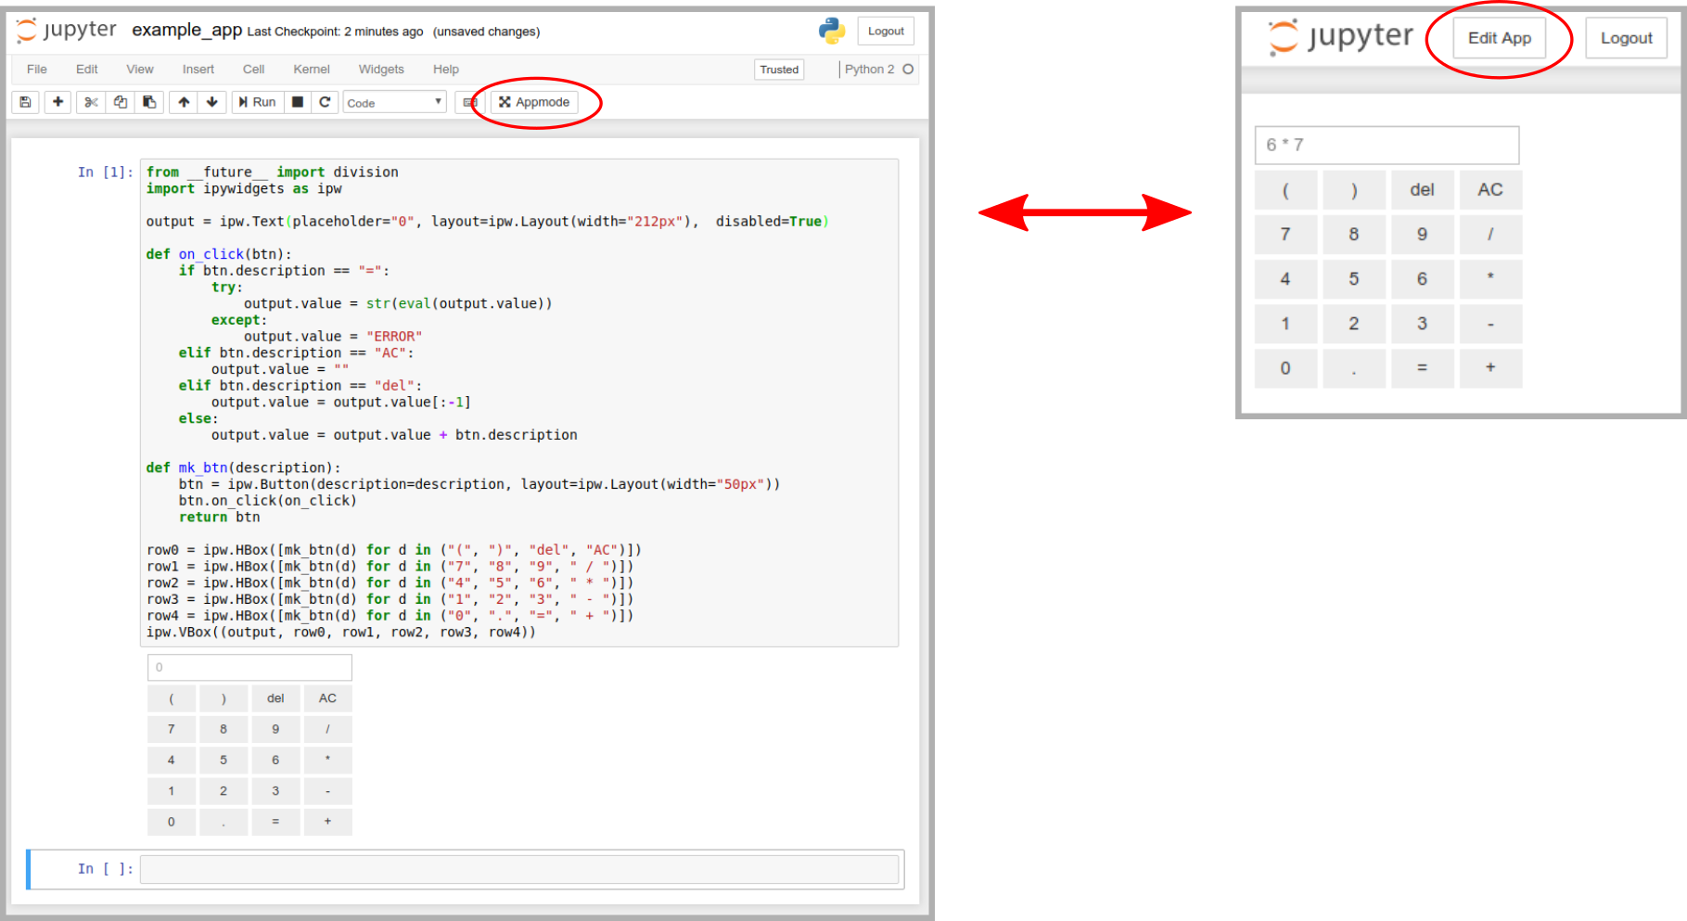
App in a notebook
Notes:
We will look at GUIs in later lecture, but here is a teaser
Widgets + Appmode = Application
When a notebook is opened in Appmode:
a dedicated kernel is launched to allow for concurrent views.
code cells and the toolbar are hidden to provide a clean UI.
all cells are executed automatically.
Multiple notebooks can be linked via url parameters to create even more sophisticated user experiences.

Slide 26
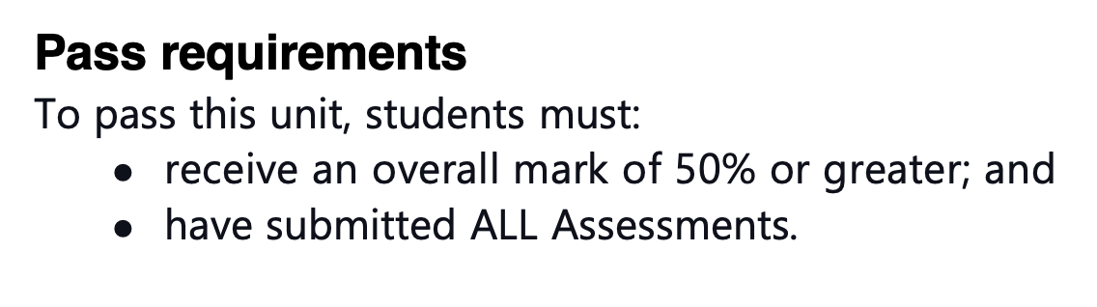
The Real reason everyone is here…

Slide 27
Extended Learning Portfolio (ELP)
Designed to take 3-5 Hours
24 Hour Window
Starts at published time ENDs next day
Check Official timetable!
Download → complete → Submit
Download when want, must submit by end time
Download DOES NOT change time due
5 ‘main’ questions
Need to create 1-2 GitHub repositories
Need to write 1 or more notebooks
Copy: Body of Journals → Word document → Turnitin

Slide 28
Apply what you know in a new and novel way

Slide 29
Question Ideas
Reflective Writing (Journals as a doc)
Most important ULO, Why
Best activity/notebook, Why
Supported using example of your work
Design a program to…(Step 1-4 of methodology)
Implementation the following… (I/O, testing, interface, github)
Fix/test/debug notebook/cell (logical, syntax, debugging, exceptions)
Explain/Complete some code or algorithm
Add comments (inline/function)
Improve variable/function names

Slide 30
ELP Tips
Focus - Application of Knowledge
Logic important Syntax less so
Explain/Demonstrate in psuedocode
Correct Syntax bonus marks
Answer the Question
Show me what you know
No Answer - round figure
Worst Case - rewrite the question

Slide 31
If you can’t do something, then the next best thing is to document what you want to do. Not as good as doing it, but better than not mentioning it.

Slide 32
Revision Strategy
Blackboard (Lecture notes, Videos, notebooks)
Review all notebooks
Delete answer and try again
Online Judge
YouTube
Socratica Python Playlist
See Blackboard

Slide 33
Important Notebooks
Design - Calculator Walkthrough
Implementation - (Good) Calculator Walkthrough
Testing (assert/doctest)
Pay Calculator (Forms and ipywidgits)
Input validation
Simple Dashboard

Slide 34
Can You…
Provide an overview of ULO
Provide an overview of Lectures
Discuss Extended Learning Portfolio
Questions
Study Strategies

Slide 35

S1 / 2015

Slide 36

Why eVALUate?
eVALUate is Curtin’s way of getting feedback on your experience in a unit and with your teachers.
This feedback helps us to improve your learning experience in individual units and the overall course.
We tend to only give feedback when something is really good or really bad. But we also want all the important feedback that sits in the middle. This helps us to improve and be better at what we do.
Be professional when completing the survey – remember that integrity and respect are important Curtin values. You can be constructive and kind at the same time.
#bekind eVALUate now!
A global university Western Australia | Dubai | Malaysia | Mauritius | Singapore

Slide 37

Giving constructive feedback…
You can comment on:
Some tips on giving feedback:
Assessment and feedback
Lecture and tutorial content
Organisation and structure of the unit
Teaching methods
Use of technology
Communication between you and your teacher
Be specific with your comments and provide relevant examples
Avoid comments that are personal (dress, appearance, manner, etc.) - focus on the teaching and learning activities
Try to describe the effect of the teacher’s behaviour on your learning and offer alternatives so that we can improve
Be respectful - do not write anything that is offensive, racist or sexist
Avoid emotional language
Comment on both the good and bad parts of the unit and/or teaching

Slide 38
Some examples…
Instead of this… | Try this…
My tutor was boring and seemed disinterested. | My tutor could try and make the class more interesting by providing real-life examples and engaging the class more in discussion.
The feedback I got on my assignment didn’t help me at all. | Specific feedback on how I could improve my writing would be really useful and help me in my further studies.
I can’t understand a thing the lecturer is saying – it’s like he speaks another language. | It would be helpful if the lecturer spoke slower and emphasised the main points.
My tutor was great! | My tutor as great because she explained everything clearly and was open to questions. She was also enthusiastic and clearly loves her job.
I enjoyed this unit. | I enjoyed this unit because the lecturer was organised and was passionate about the topic. I really liked the way he brought in guest lecturers from industry to give us some real life examples. The assignments were also really useful for my career development.
My tutor never responded to my emails – does he even work here? | Perhaps the tutor could be more organised in the way he responds to emails and student queries. A timely response would really help my understanding of the unit content.

Slide 39
"You are braver than you believe, stronger than you seem, and smarter than you think." — Christopher Robin, Winnie the Pooh.

Slide 40
Thank You!

